Slide 1
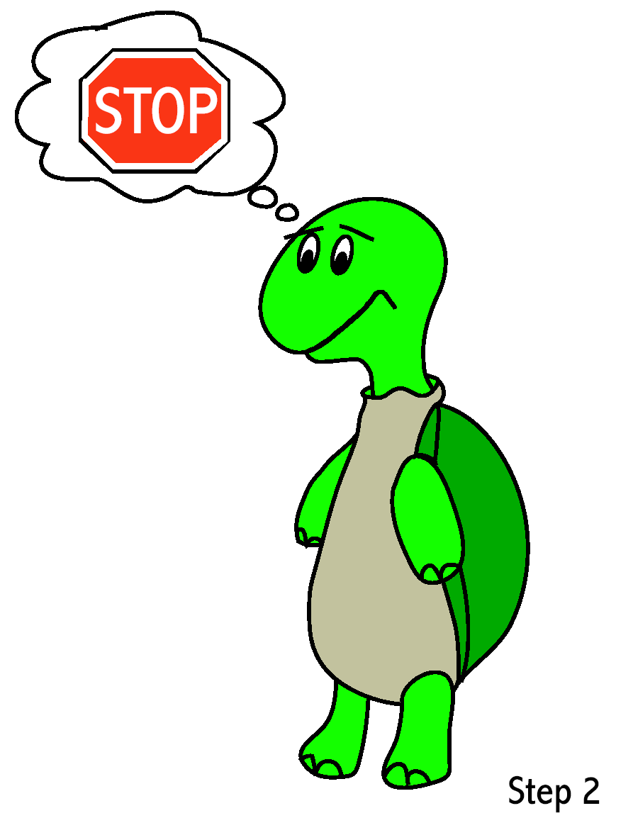
Promoting
Social Emotional Skills at Home

Slide 2
Agenda
Problem Solving Steps and Solutions
Conflict Resolution Process
Tucker Turtle
Self-regulation strategies
Resources
A Child's View to Calming Down
Notes:
Play video before moving on to the next slide

Slide 3
Problem Solving involves...
Using key steps to solve conflicts
Thinking of alternative solutions
Learning that solutions have consequences
Learning to evaluate solutions - Is it safe? Is it fair? Does it bring about good feelings?
What to do when a solution doesn’t work

Slide 4
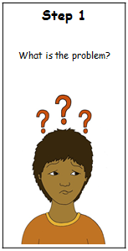
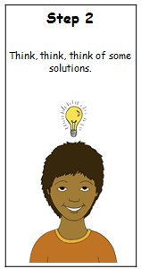
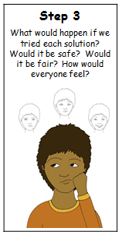
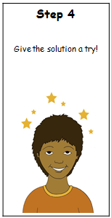
Problem Solving Steps
Would it be safe?
Would it be fair?
How would everyone feel?
Notes:
Discuss BREATHE, THINK and DO app from Sesame Street

Slide 5
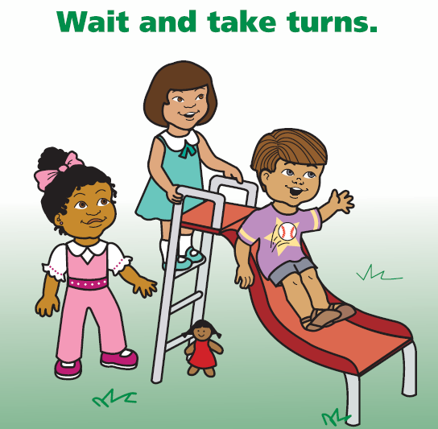
Help the Child Think of a Possible Solution:
Get an adult
Ask nicely
Ignore
Play
Say, “Please stop.”
Say, “Please.”
Share
Trade toys/item
Wait and take turns
Get an Adult
Notes:
It is important that children learn the “get an adult” solution first so that as the child is learning these solutions the adult can help keep all children safe and/or guide other possible solutions and help scaffold peer interactions. Other possible solutions are: take a break, get a friend, get help, talk about it, walk away, etc.

Slide 6
Other possible solutions are:
take a break
get a friend
get help
talk about it
walk away

Slide 7
Steps in Resolving Conflicts
1. Approach calmly
2. Acknowledge feelings
3. Gather information
4. Restate the problem
5. Ask for ideas for solutions and choose one together.
6. Be prepared to give follow-up support
Notes:
Ask volunteers for role playing or give vignettes.

Slide 9
Supporting Young Children with Problem-Solving in the Moment
Anticipate problems
Seek proximity
Support
Encourage
Promote

Slide 10
Controlling Anger and Impulse
Recognizing that anger can interfere with problem solving
Learning how to identify anger in oneself and others
Learning how to calm down
Understanding appropriate ways to express anger
Notes:
It is ok to get angry. Wait for the child to calm down before talking to him or her.

Slide 11
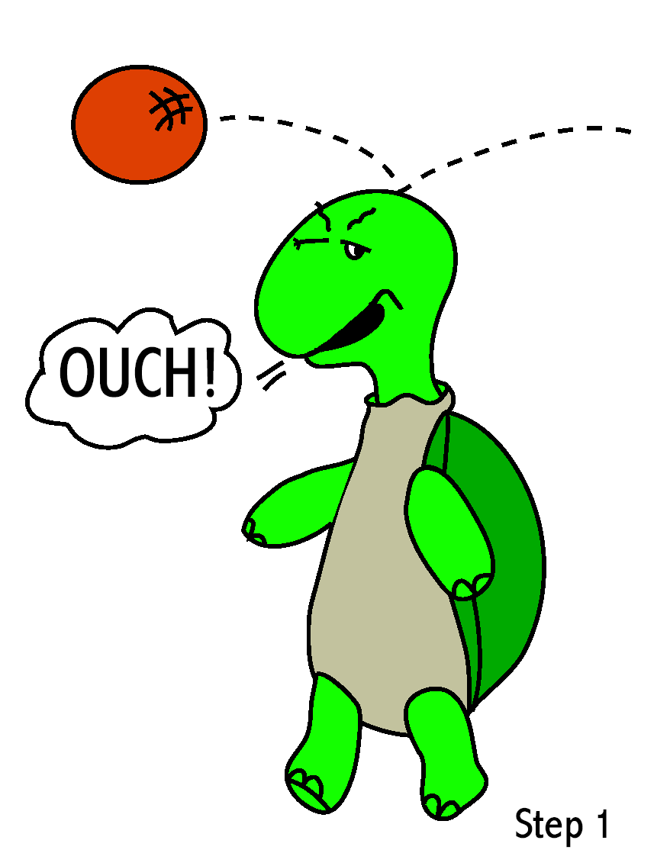
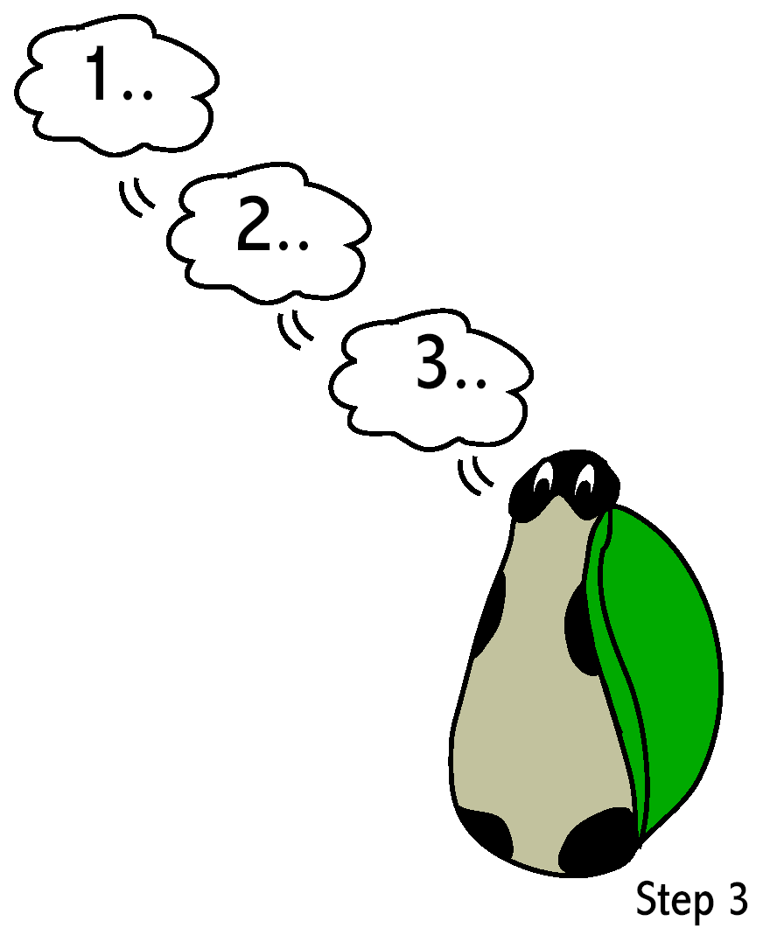
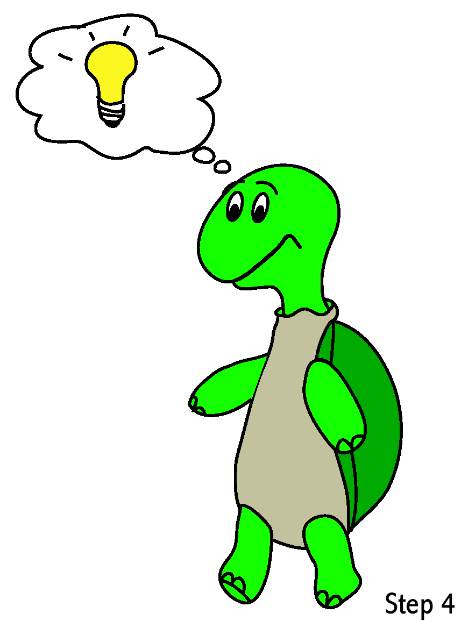
Turtle Technique
Recognize that you feel angry.
“Think” Stop.
Go into shell.
Take 3 deep breaths. Then, think calm, coping thoughts.
Come out of shell when calm and think of a solution.
Notes:
Turtle puppets with retractable heads can be found at: http://www.folkmanis.com/handpuppet_detail.php

Slide 12
A scripted story to assist with teaching the “Turtle Technique” By Rochelle Lentini March 2005
Tucker Turtle Takes Time to Tuck and Think
Tucker Turtle Takes Time to Tuck and Think at Home
Notes:
Talk about “Think, Breathe, and Do” app from Sesame Street

Slide 13
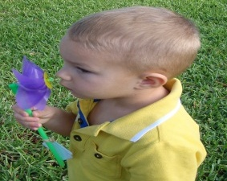
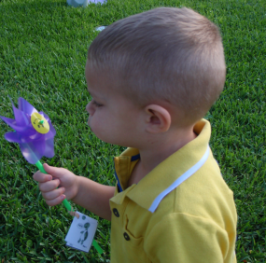
Teach and Practice How Tucker Breathes
FIRST
THEN
Tucker Turtle
knows how to
smell flowers
STOP
& blow pinwheel
Notes:
Breathing techniques are important to help a child calm down and regulate themselves. Many child do not understand the concept of breathing in or taking a deep breath and then breathing out to release it. There are many ways to teach this skill!
Smell the flower, blow out the candle
“smell the hot chocolate, and blow it to make it cool.”
Blowing bubbles
Raising hand up then lowering hand down

Slide 14
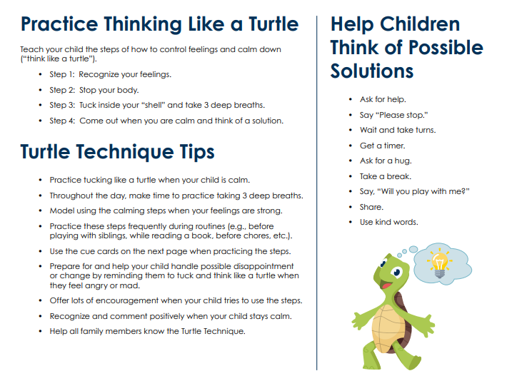
Notes:
This is a review of the Turtle Technique and can be used as your “cheat sheet” Remember the steps to thinking like a turtle to get you to a solution.

Slide 15
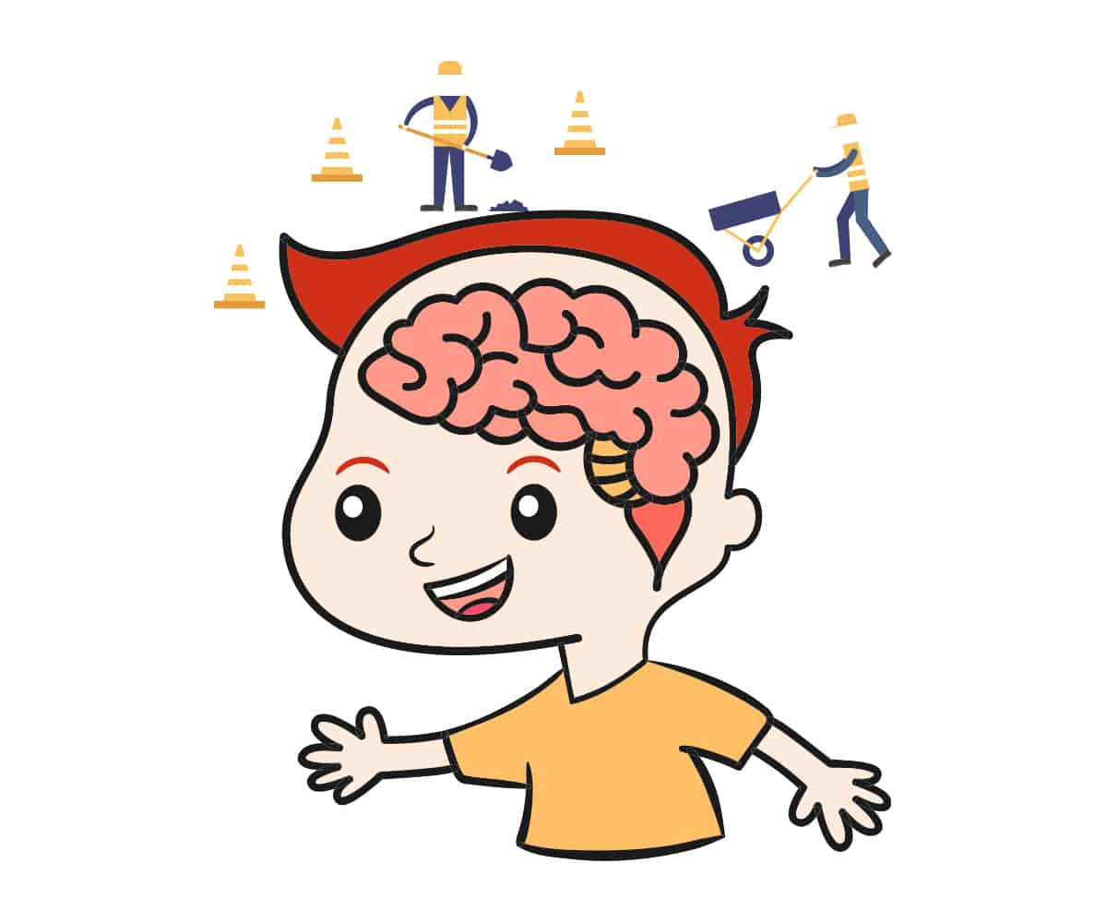
Self-Regulation
The ability to understand and manage ourselves:
Behaviors
Emotions
Reactions
Regulating your own self in specific situations
Keeping the body, mind, and emotions on task

Slide 16
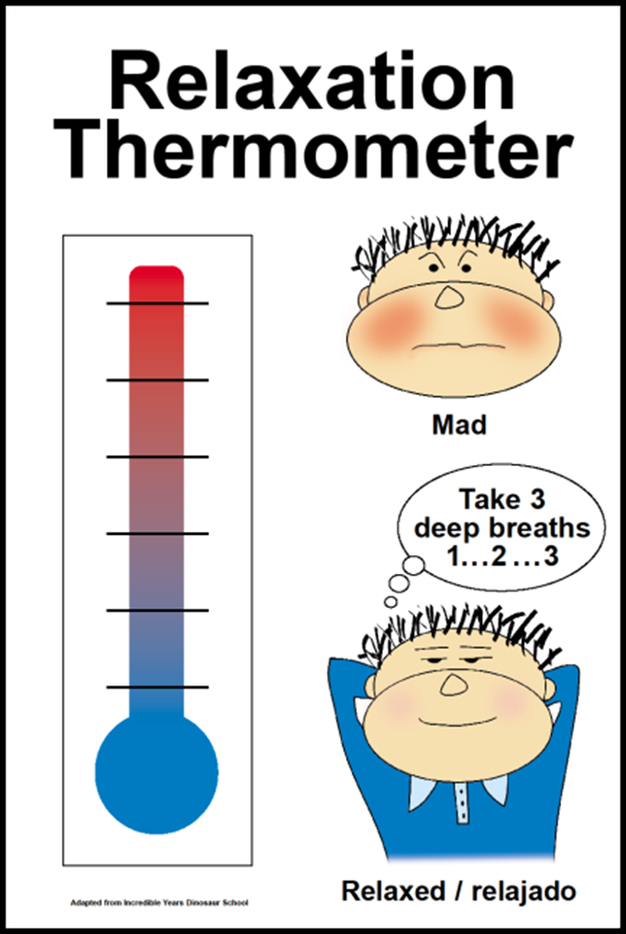
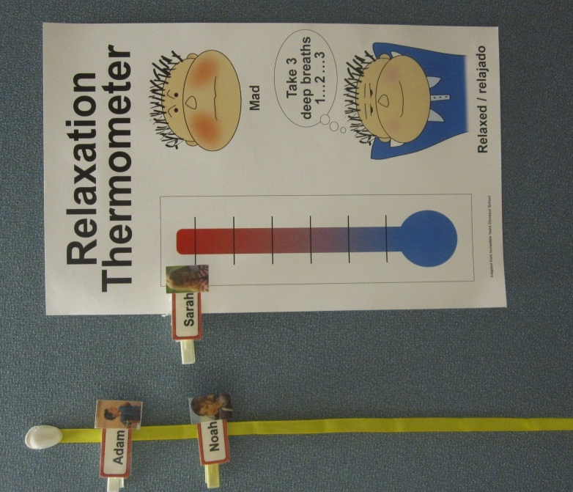
Notes:
Use clothes pins for name and/or picture of student

Slide 17
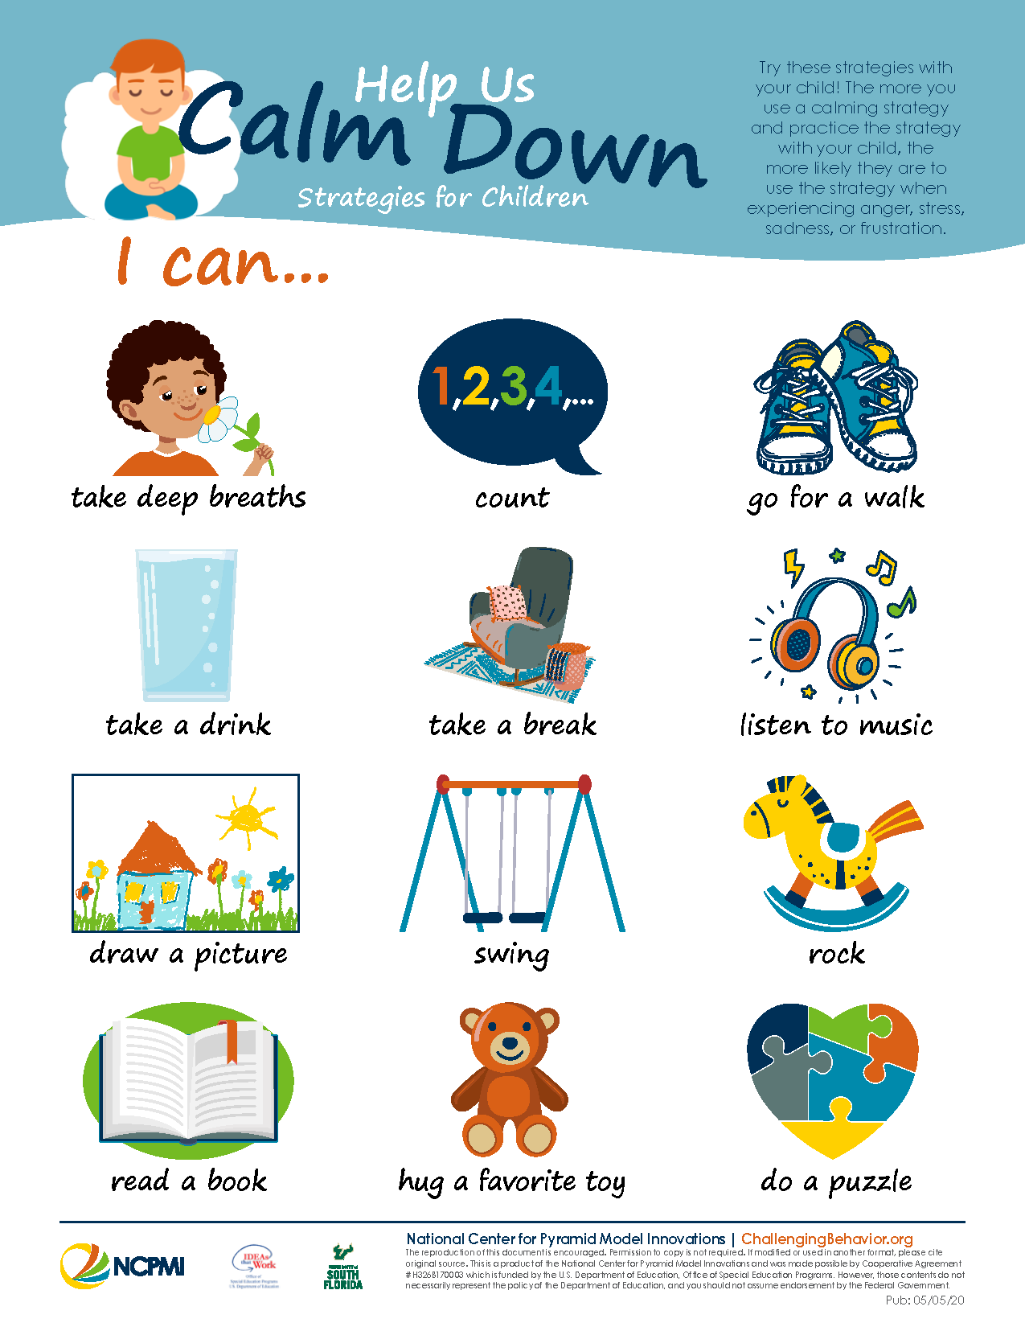

Slide 18
Something to think about….
When little people are
overwhelmed by
BIG EMOTIONS
It is our job to
share our CALM
and not join their chaos.
- L. Knost

Slide 19
Survey Time!!
Please don’t forget to take our Parent Survey. The information from this survey helps us plan and implement workshops and resources based on family needs!
Parent Survey
THANK YOU!!!!

Slide 20
Resources
Breathe, Think, and Do with Sesame (download the free app on Apple or android and any tablet) https://youtu.be/yu0YEii4FkQ
CSEFEL: Center on the Social and Emotional Foundations for Early Learning (vanderbilt.edu)
Solution Cards for Home
Problem Solving Story
Deep Breathing Printable

